Slide 1
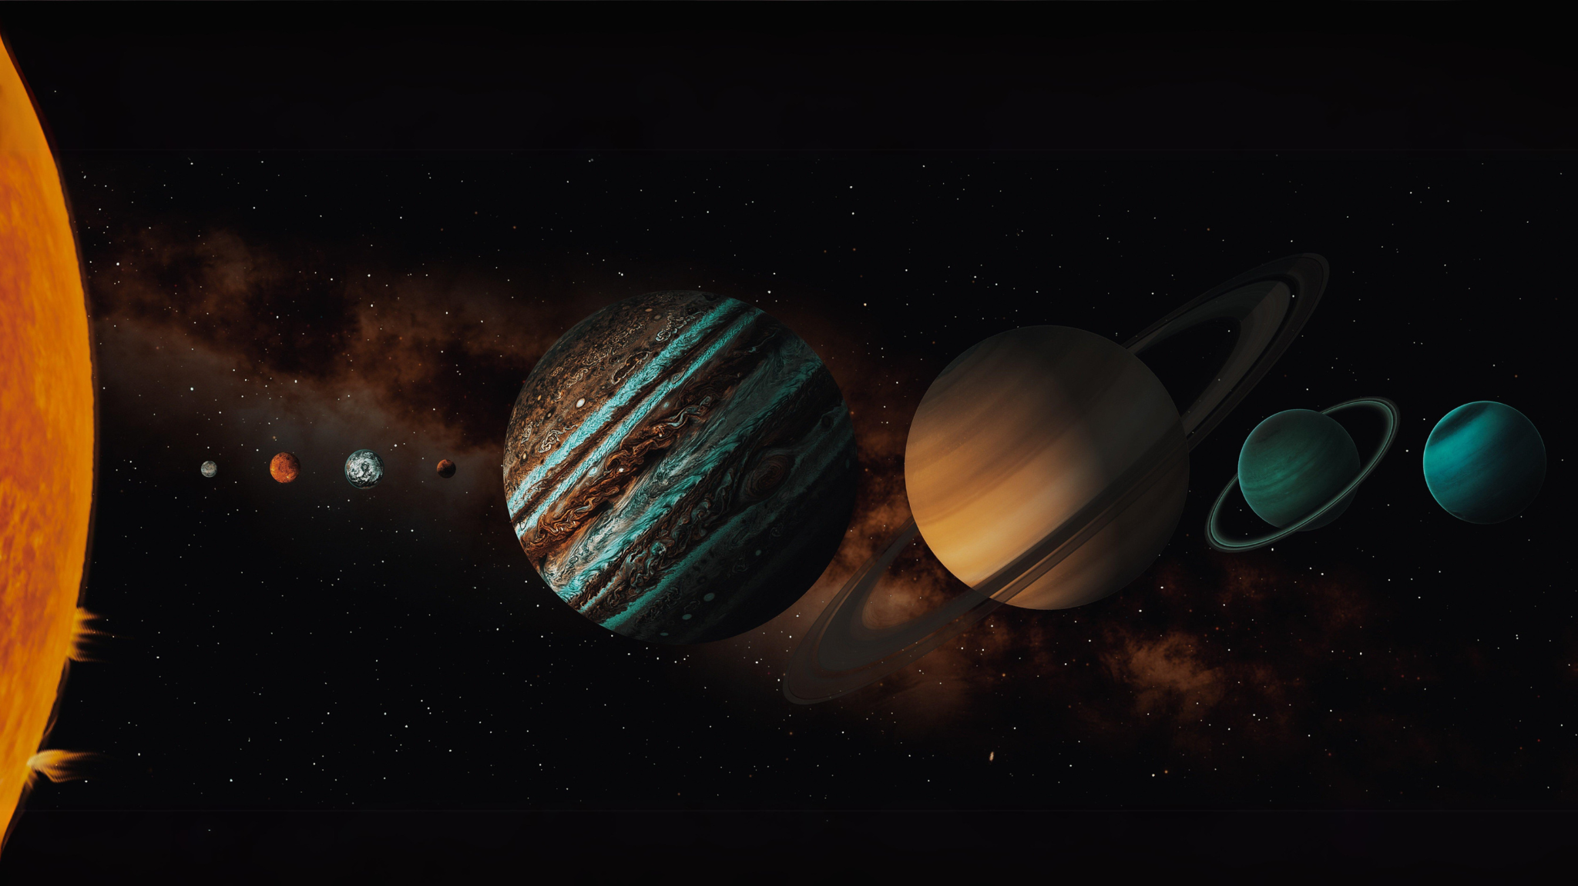
Orrery Web App
(Real-Time Solar System and NEO Visualization)
Presented By:

Slide 2
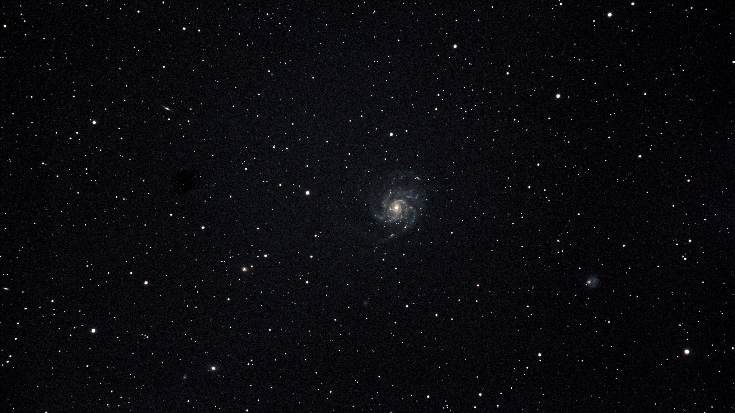
TABLE OF CONTENTS
01
02
03
04
05
06
INTRODUCTION
PROBLEM
STATEMENT
PROPOSED
SOLUTION
SCOPE
FEATURES
CONCLUSION

Slide 3
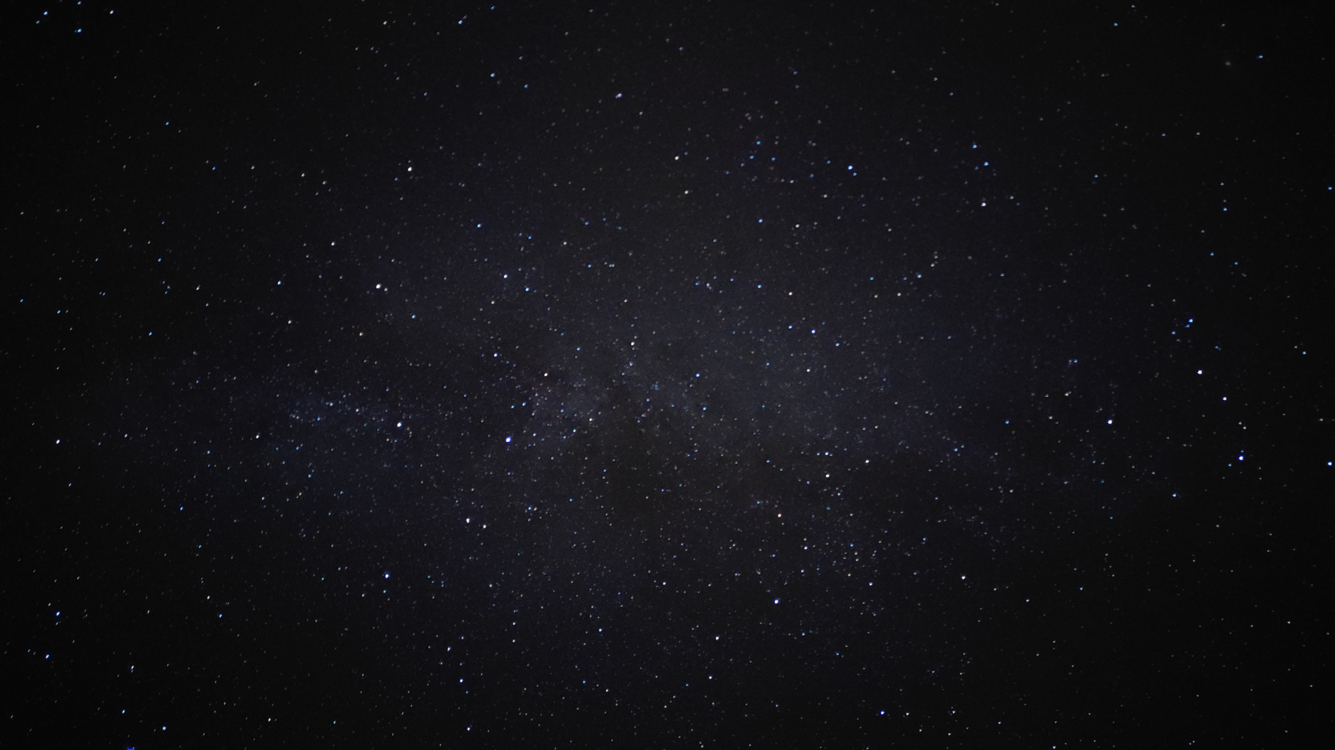
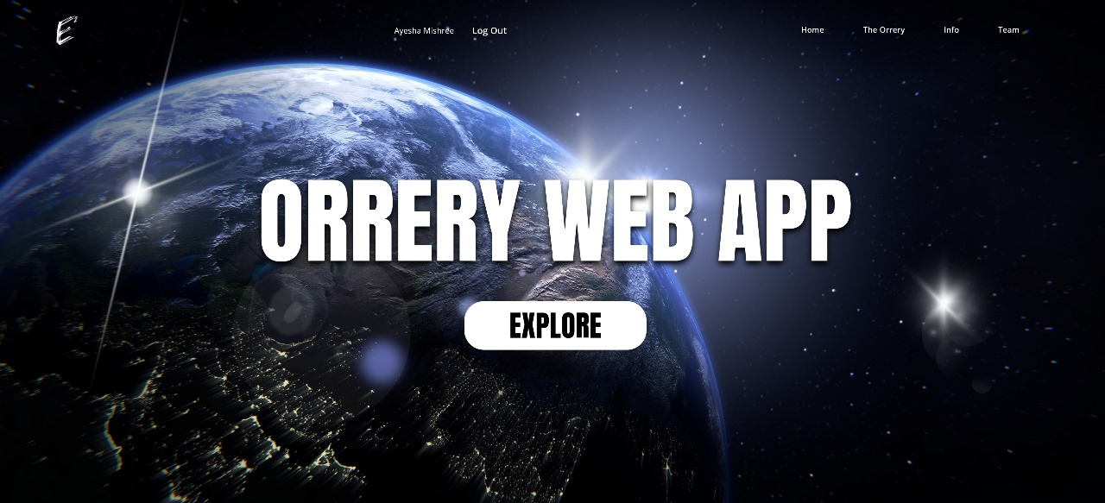
Astronomy has intrigued humans for centuries.
Modern tools enable dynamic simulation of the solar system.
Our project creates an interactive orrery web app for real-time celestial visualization.
INTRODUCTION
Human fascination with space dates back centuries.
Astronomy helps us understand our place in the universe.
Traditionally, space learning tools are static or outdated.
Our goal: Build an interactive, real-time solar system simulation accessible via the web.
Allows users to explore planets, asteroids, and NEOs dynamically.

Slide 4
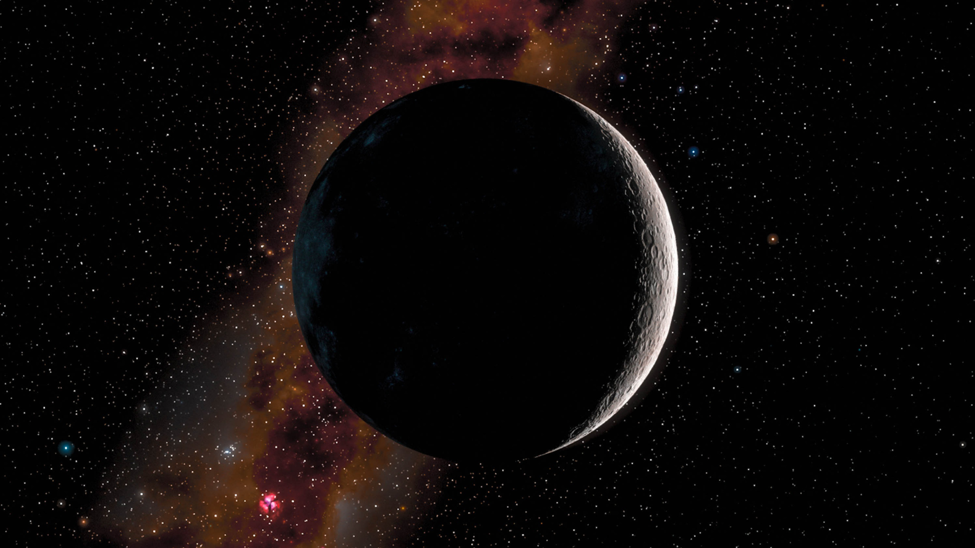
OVERVIEW: Interactive 2D Orrery Web App
Purpose: A 2D web app that visualizes the solar system and Near-Earth Objects (NEOs) in real-time.
Key Features:
Displays orbits and movements of planets, asteroids, and comets
Real-time data fetched from NASA APIs
Interactive and educational experience
Technology:
Powered by NASA's live data for accuracy and up-to-date info
Users can zoom, navigate, and explore different celestial bodies
User Experience:
Intuitive interface for switching views
Enhances understanding of solar system dynamics and asteroid behavior

Slide 5
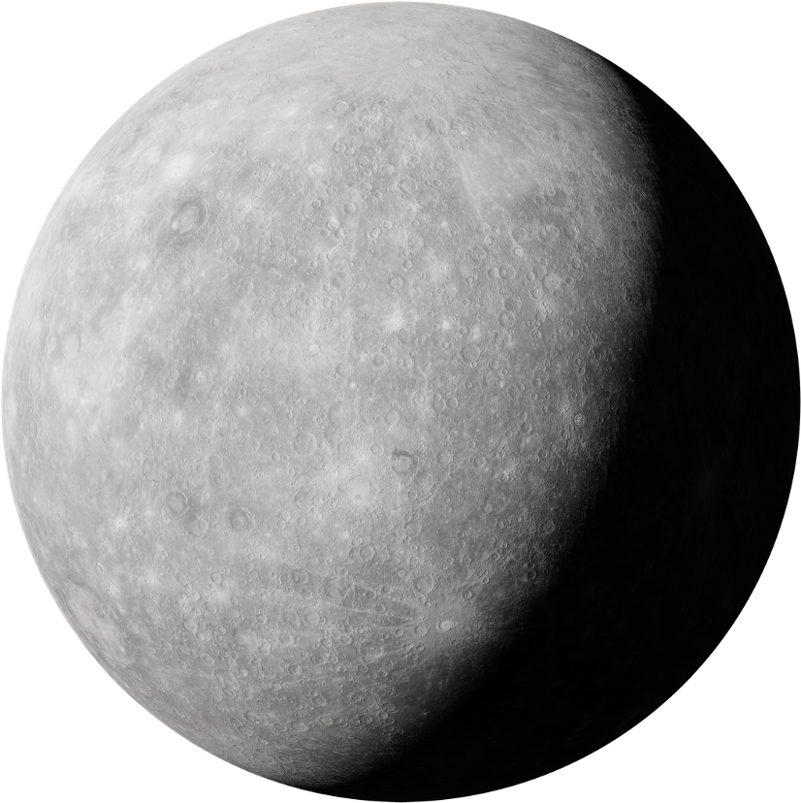
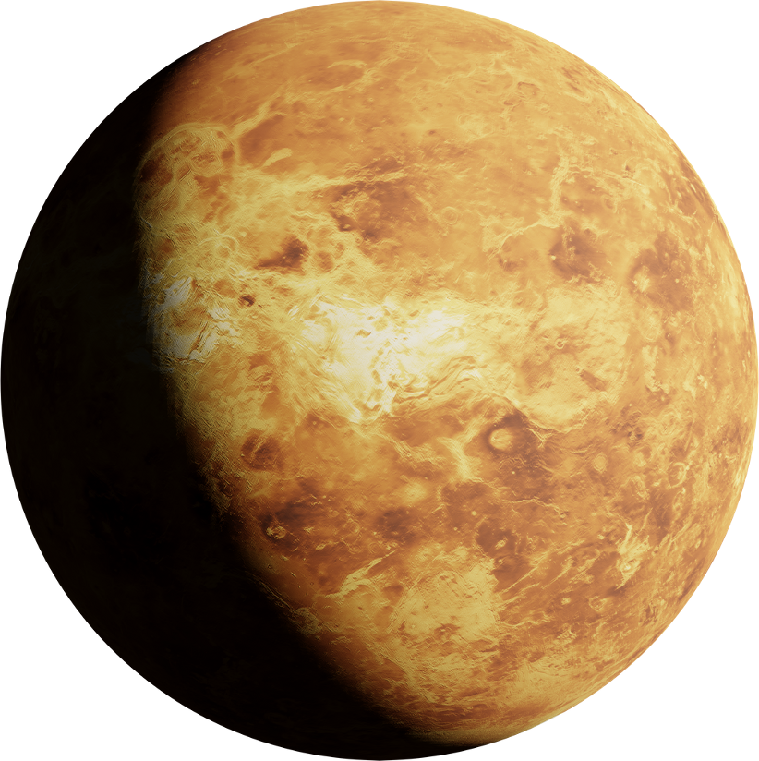
PROBLEM STATEMENT
Many solar system visualizations are:
Static and non-interactive
Not updated with real-time data
Lacking educational usability
There's a gap in tools that blend interactivity, live data, and user accessibility.
Need for a platform that makes space exploration engaging, current, and easy to use.

Slide 6
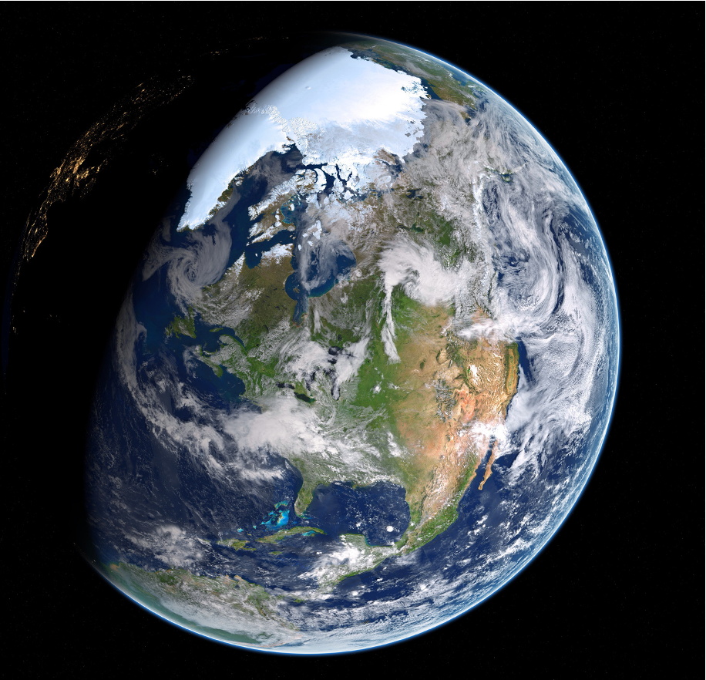
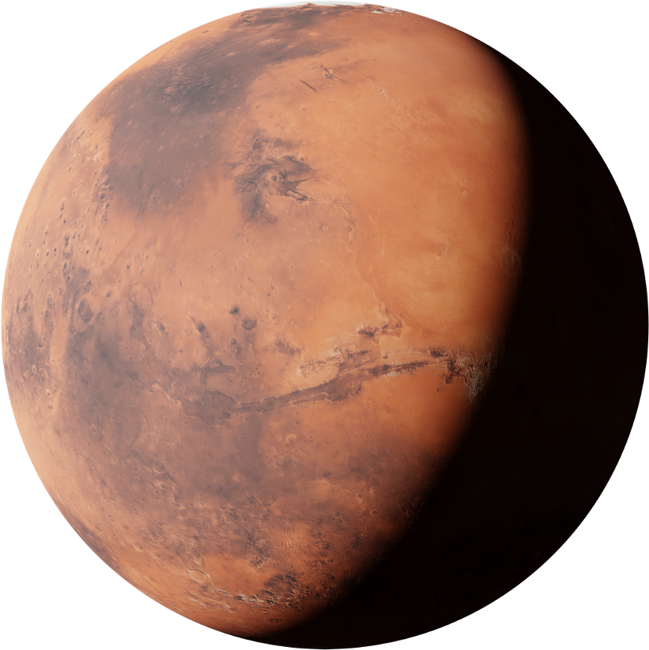
PROPOSED SOLUTION
A web application that:
Offers real-time, interactive solar system visualization
Integrates live data for planetary and asteroid positions
Enables user authentication and personalization
Uses modern tools like Firebase, Flutter, and Node.js

Slide 7
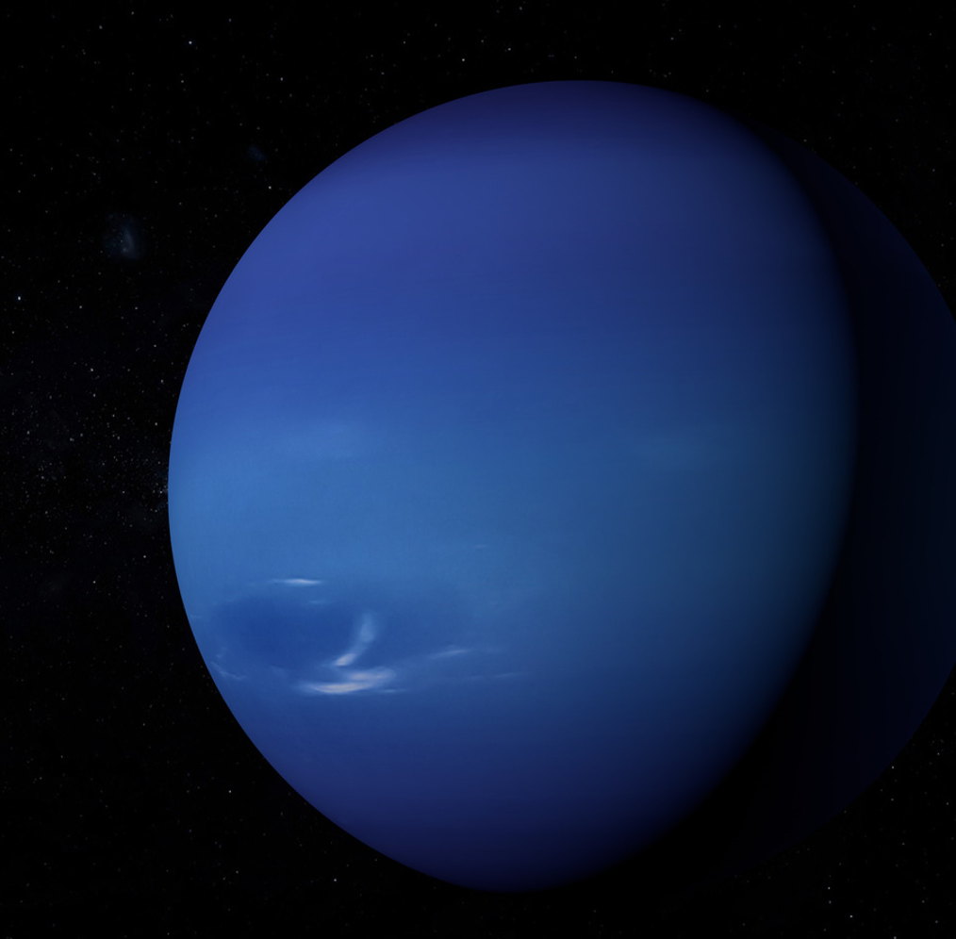
SCOPE
This project aims to build a real-time, web-based application that visualizes the solar system and Near-Earth Objects using live data. It includes an interactive Flutter orrery, Firebase authentication, Firestore for data storage, and a Node.js backend for API integration. The system will be containerized using Docker. Advanced simulations, mobile versions, and social features are not included.

Slide 8
Users can:
Zoom in/out
Pan around the solar system
Select planets or asteroids to focus on
Designed for intuitive exploration
FEATURES
Interactive Model
Real-Time Visualization
Dynamic orrery model that updates positions of planets and NEOs in real time
Accurate orbital paths visualized through API data
Helps users see the current state of the solar system.
Users can:
Zoom in/out
Pan around the solar system
Select planets or asteroids to focus on
Designed for intuitive exploration

Slide 9
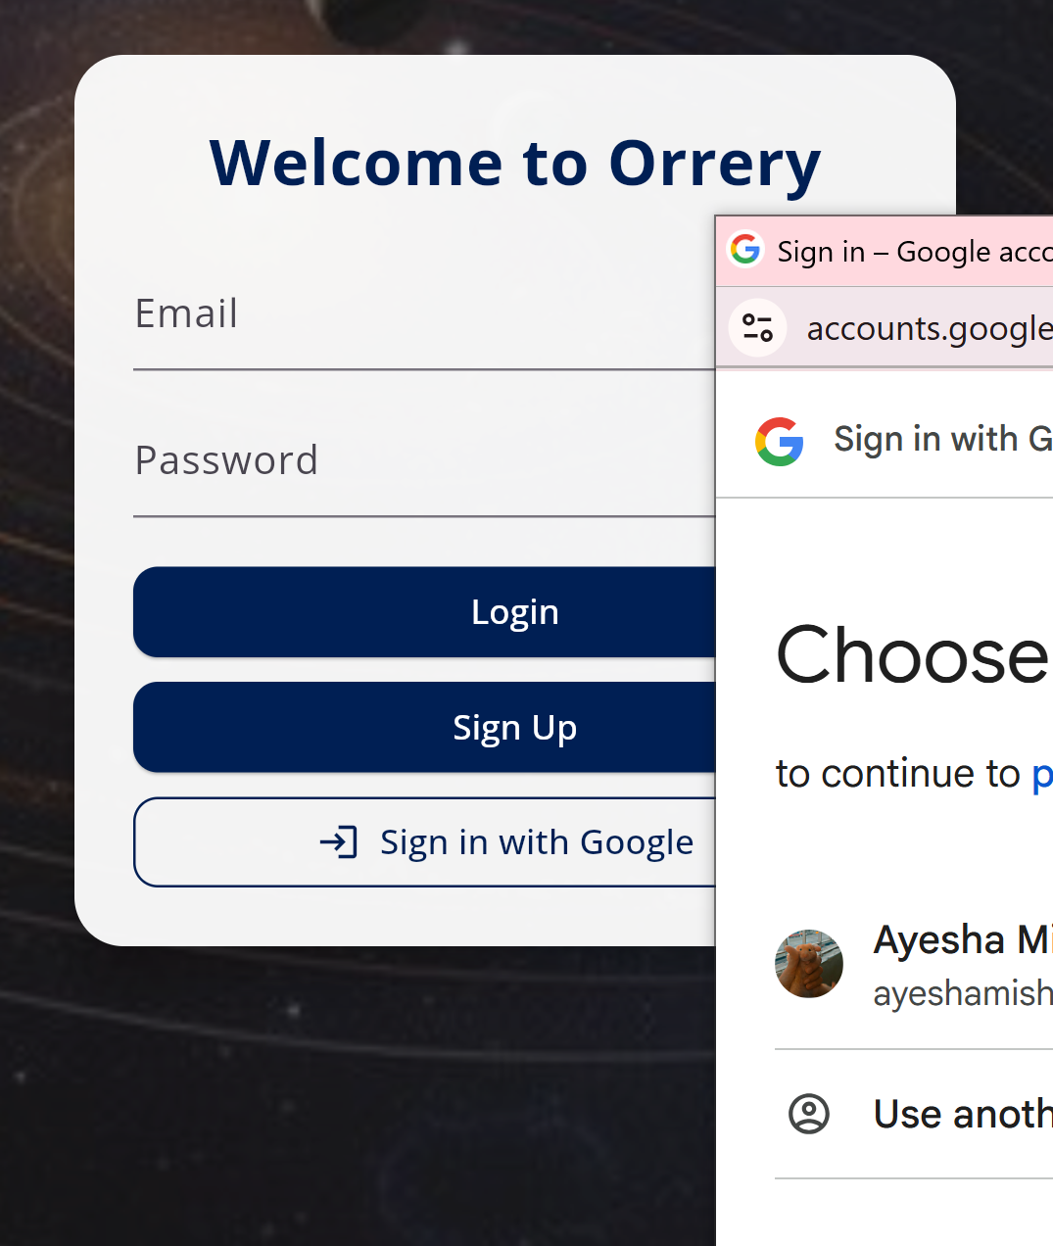
Users can:
Zoom in/out
Pan around the solar system
Select planets or asteroids to focus on
Designed for intuitive exploration
FEATURES
User Authentication
Secure login system using Firebase Authentication
Enables users to:
Register and sign in
Save preferences or bookmarks (future scope)
Maintains secure access and session tracking

Slide 10
Users can:
Zoom in/out
Pan around the solar system
Select planets or asteroids to focus on
Designed for intuitive exploration
Clean, modern design built in Flutter
Cross-platform responsive UI
Designed for educational use: easy to understand, rich in visuals
FEATURES
User Interface (UI/UX)
Data Integration
Real-time celestial data from external APIs (e.g., NASA NEO API)
Updates planetary and asteroid positions continuously
Ensures the app reflects actual celestial positions
Clean, modern design built in Flutter
Cross-platform responsive UI
Designed for educational use: easy to understand, rich in visuals

Slide 11
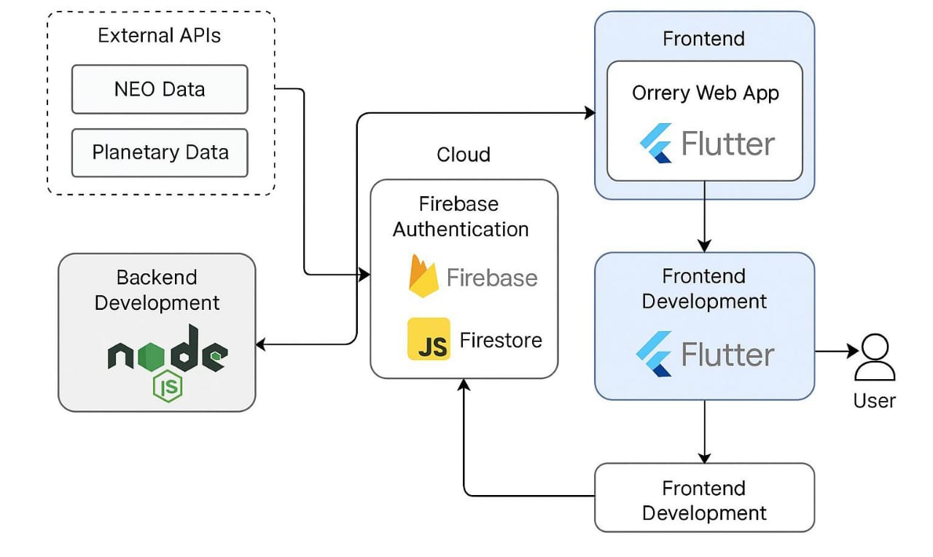
Users can:
Zoom in/out
Pan around the solar system
Select planets or asteroids to focus on
Designed for intuitive exploration
SYSTEM ARCHITECTURE

Slide 12
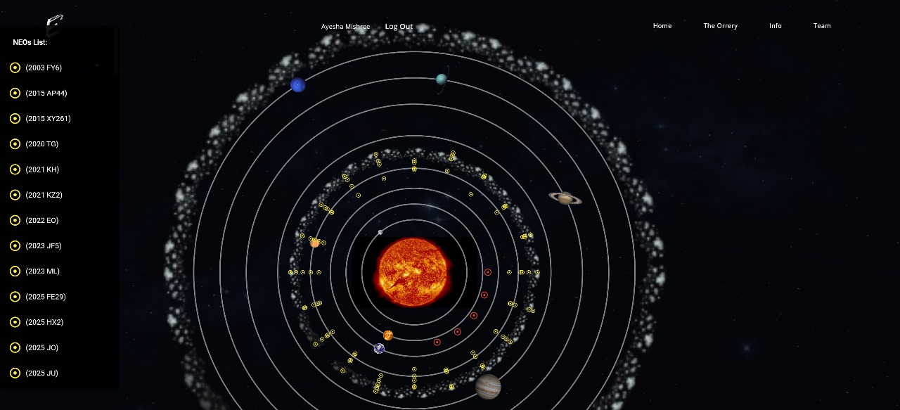
CONLUSION
Our project delivers a real-time, interactive web application that visualizes the solar system and Near-Earth Objects using live data from NASA APIs. By integrating Flutter for the frontend, Node.js for the backend, and Firebase for authentication and data management, we created a secure, user-friendly educational platform.
The application enhances user engagement and understanding of celestial movements, laying the groundwork for future expansions such as mobile access, VR integration, and advanced features.

Slide 13
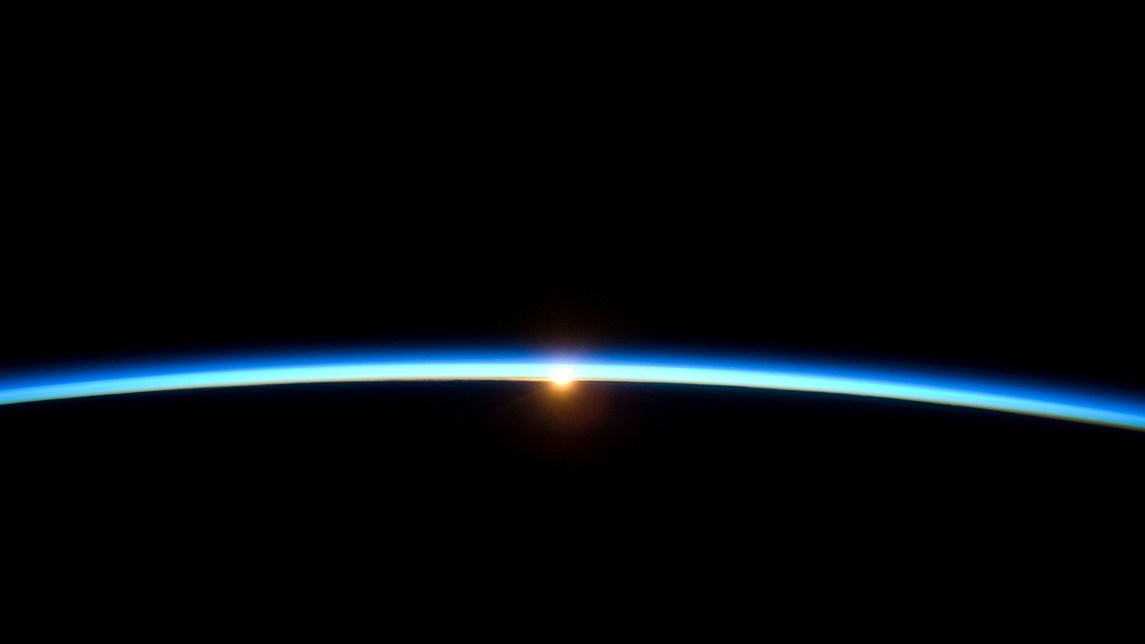
THANK YOU!

